Slide 1

Strings in C-Programming
Presented by:- Siburanjan Samal

Slide 2
Introduction
Strings are array of characters i.e. they are characters arranged one after another in memory. Thus, a character array is called string.
Each character within a string is stored within one element of the array successively.
A string is always terminated by a null character (i.e. slash zero "\0").

Slide 3
Strings....
Operations performed on string includes:-
Reading and writing string.
Copying one string to another.
Combining two string.
Comparing string for equality.
Extracting a portion of string.

Slide 4
Declaration of string
A string variable is declared as an array of characters.
Syntax:-
char string_name[size];
E.g. char name[20];
When the compiler assigns a character string to a character array, it automatically supplies a null character ('\0') at the end of the string.

Slide 5
Initializing String Variables
Strings are initialized in either of the following two forms:
char name[4] = {'R','A','M','\0'};
char name[] = {'R','A','M','\0'};
OR
char name[4] = "RAM";
char name[] = "RAM";
When we initialize a character array by listing its elements, the null terminator or the size of the array must be provided explicitly.
R | A | M | \0
name[0] | name[1] | name[2] | name[3]

Slide 6
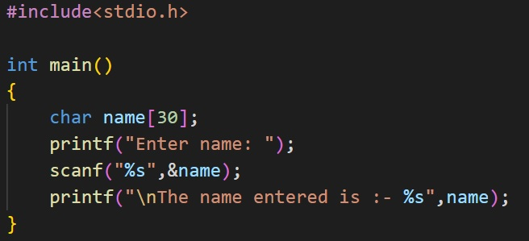
Reading and displaying String

Slide 7
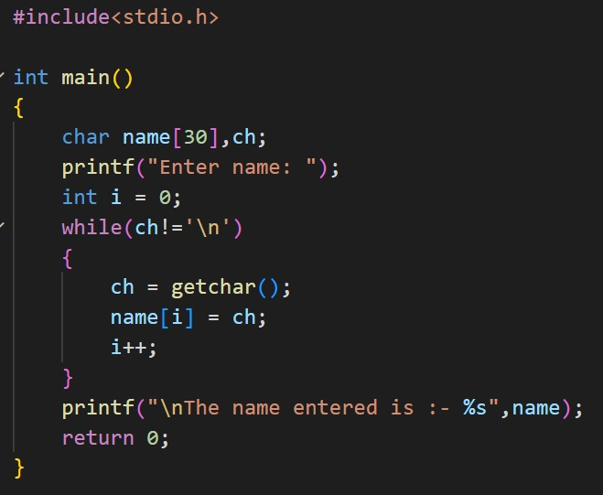
It can also be done manually using getchar()

Slide 8
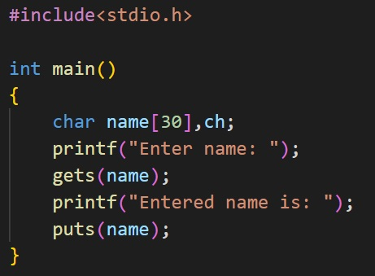
using gets() and puts()

Slide 9
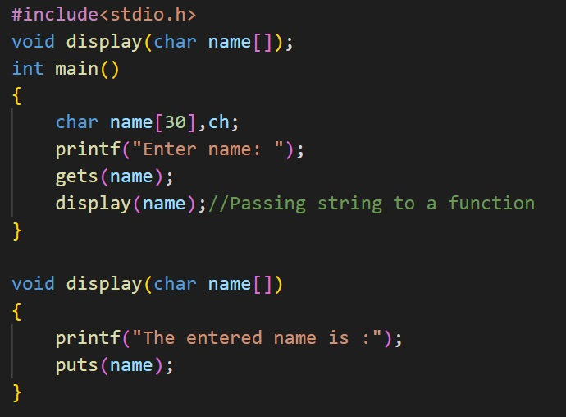
Passing string to function

Slide 10
String handling functions
Strings need to be manipulated by programmer.
It can be done manually but it is time consuming such as:-
Counting length of the string
Copying one string to another
So, to make string handling simpler and faster there are various string handling functions defined in string.h .

Slide 11
Some of the string handling functions are:
Functions | Work of Function
strlen() | Calculates the length of string passed
strcpy() | Copies a string to another
strcat() | Concatenates two string
strcmp() | Compares two strings
strlwr() | Converts string to lowercase
strupr() | Converts string to uppercase

Slide 12
Array of Strings
String is an array of characters.
Thus, an array of string is 2-D array of characters.
E.g.
Char name[5][10];
Here, name[5][10] means 5 names having 10 character each.

Slide 13
Thankyou!
Welcome your questions ?

